Slide 1
Design of Graph Processor for graph algorithms
Mentored by professor Sukanta Das
1. Sushobhan Mahato
Enrollment No - 2020ITB059
2. Ayush Utkarsh
Enrollment No – 2020ITB069
3. Parth Mehendru
Enrollment No – 2020ITB074
Department - Information Technology, UG , 4rd Semester
IIEST Shibpur

Slide 2
Introduction to Graph Processing
Usefulness of graphs in making advance computational architecture for large scale data computation.
Conventional processor architectures are unable to handle the throughput and memory requirements of graph computation.

Slide 3
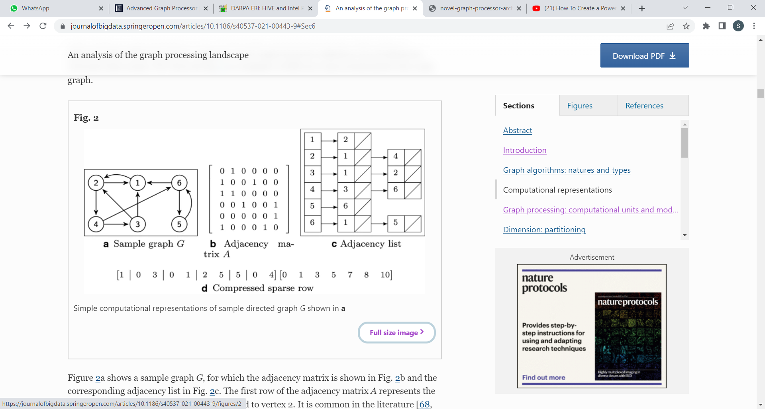
Representation of Graphs for graph processing
A graph G is written as G = (V, E), V is a set of vertices and E is set of edges. In general E is a sub-set of (V×V) . If it is a ordered pair then the graph will be directed else if it is un-ordered then it is a un-directed graph.
For digital computation graphs are generally represented as adjacency list or adjacency matrix.
If the number of edges are less as compared to the number of nodes then it is more efficient to represent it as a sparse matrix.

Slide 4
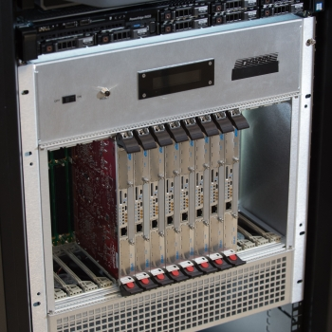
Graph Processor
A hardware, which is developed to be used as a computational architecture for analysing large scale dataset using graph algorithms efficiently.

Slide 5
Properties of Graph Processor
High band-width communication network
Sparse matrix based graph instruction set
Accelerator-based architecture
Cacheless memory system

Slide 6
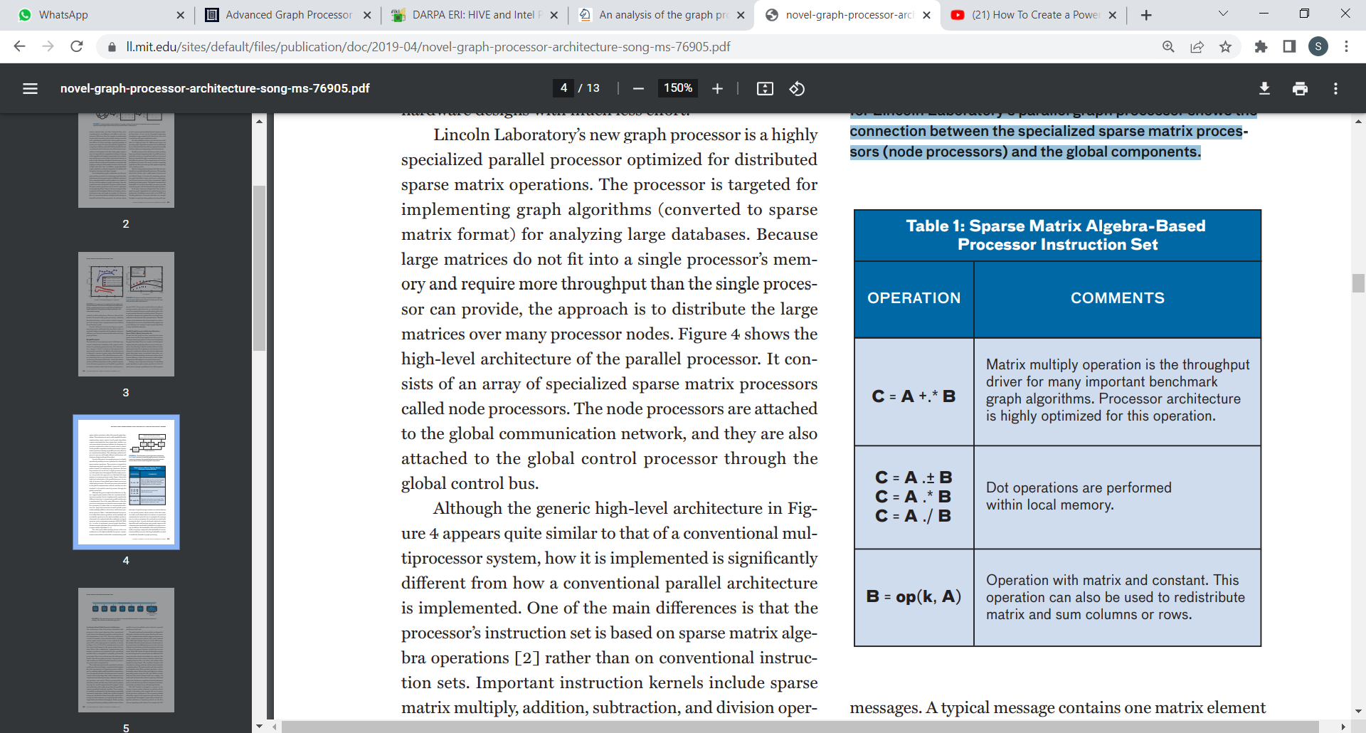
Parallel Graph Processor Architecture Based on a Sparse Matrix Algebra Instruction Set
Global communication network (optimized for small communication messages)
Global communication network (optimized for small communication messages)
Node processor
Node processor
Node processor
Node processor
--------
i/o
Global control processor
Global control bus
The illustration of the high-level architecture for Lincoln Laboratory’s parallel graph processor shows the connection between the specialized sparse matrix processors (node processors) and the global components.

Slide 7
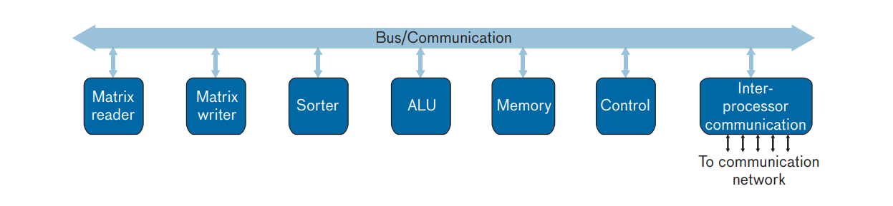
Accelerator-Based Node Processor Architecture
Consists of accelerator modules like matrix reader, matrix writer, sorter, arithmetic logic unit (ALU), and communication modules.
These are used to read, write and compute data , indices-related computations, and memory operations.
The new node processor architecture uses specialized modules to speed up sparse matrix processing. (ALU stands for arithmetic logic unit.)

Slide 8
Graph processing: computational units and models
Units
Vertex-Centric (TLAV)
Edge-Centric (TLEV)
Sub-graph-Centric (TLAG)
Models
Superstep Paradigm
Scatter-Gather
Gather-Apply-Scatter

Slide 9
Graph algorithms: natures and types
Traversals-
BFS
Single-source shortest-paths (SSSP)
k-hop neighborhood
2. Graph analysis
3. Component identification
Types of challenges in graph processing
1. Data-driven computations
2. Irregular problems
3. Poor locality
4. High data-access-to-computation ratio

Slide 10
Useful domains in graph processing
analyzing social networks
transaction processing
finding the shortest or fastest routes on maps
routing robots
analyzing DNA
corporate scheduling
network optimizations for communication
Transportation
World wide web

Slide 11
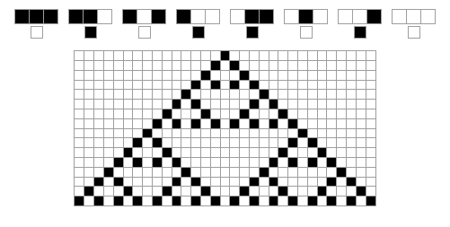
Design of cellular automata to generate spanning tree from a given planar graph
Cellular Automation -
A collection of cells in a grid, in which state of each cell is variable and depend upon it’s neighbor’s cell.

Slide 12
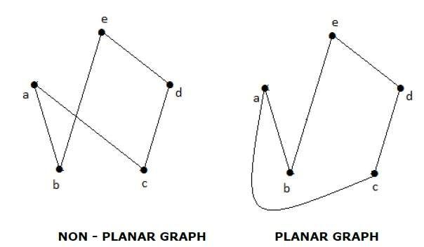
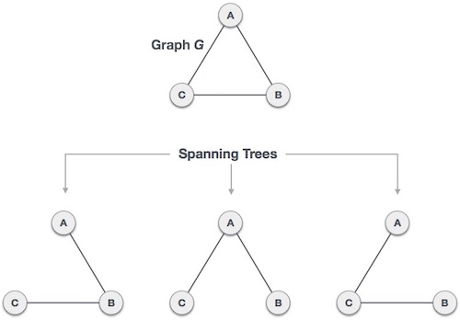
Planar Graph -
A graph that can be drawn on the plane in such a way that its edges intersect only at their endpoints.
Spanning Tree -
Connected sub-graph of a graph, includes all the vertices with minimum amount of edges.

Slide 13
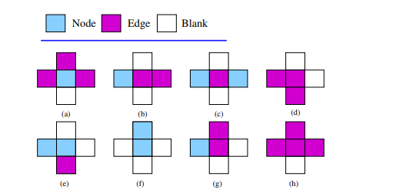
Cellular Representation of a Planar Graph
Nodes are represented in a single cell in the 2-D grid.
Edges can be one or multiple consecutive cells connecting two node cells.
Rest are blank cells.
The left, right, upper and lower cells are called neighbor of a specific cell. There are some specific regulations which each node cell and edge cell should follow.
In the picture (a-d) valid, and (e-h) are invalid representation of edge and node cells according to cellular representation of planar graph.

Slide 14
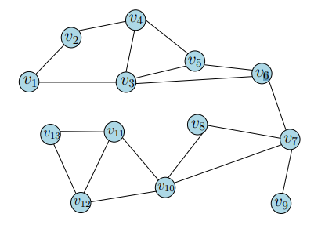
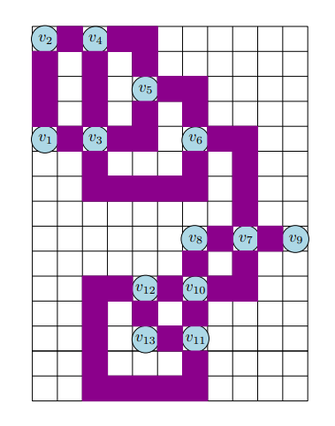
Given planar graph and it’s representation
A planar graph with degree 4
Cellular representation of the graph

Slide 15
Different states of the grid cells used in the designed CA
in = initial node in the spanning tree or the root node
u = undiscovered node
d1 = discovered node from left cell
d2 = discovered node from upper cell
d3 = discovered node from right cell
d4 = discovered node from lower cell
e = edge cell(initial)
et = discovered edge cell(during evolution), belong to the spanning tree
et’ = edge checking state
ec = discovered edge cell, does not belong to spanning tree
b = blank cell

Slide 16
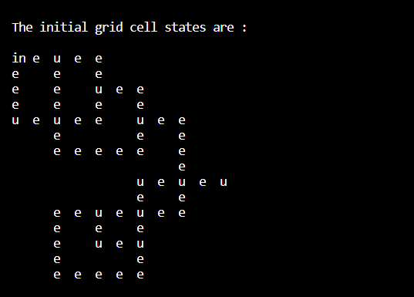
Initial states of the grid cells-
Now we start traversing the graph using bfs algorithm.
The node no 2 at point (0, 0) is the root of the spanning tree from where we will start.

Slide 17
BFS Algorithm
Algorithm to explore the nodes level-wise, of a graph.

Slide 18
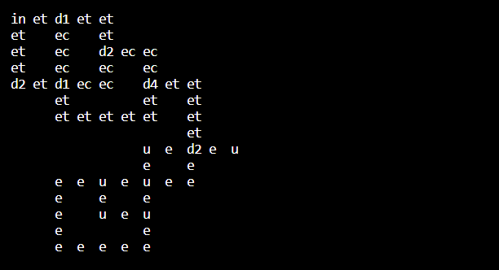
Travelling through the cellular grid
From the current node –
Go through the undiscovered cells ‘e’ updating them to ‘et’.
Update the ‘u’ to ‘d1’ , ‘d2’, ‘d3’, ‘d4’ accordingly.
After finding already discovered cell, update the edge cells to ‘ec’ to avoid cycle.

Slide 19
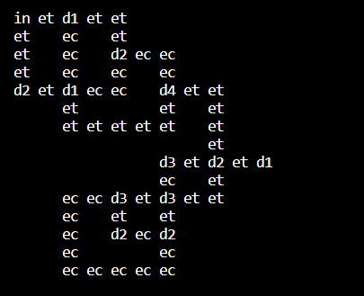
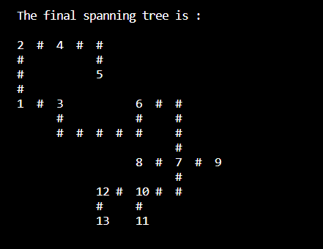
Final configuration or fixed point
After discovering all the node and edge cells -

Slide 20
Conclusion
It can conclude by saying that in the future in the field of computation with large scale database with trillions of data,
Graph Processing would have a major role.

Slide 21
References
An analysis of the graph processing landscape
Novel Graph Processor Architecture
Advanced Graph Processor
DARPA ERI: HIVE and Intel PUMA Graph Processor

